Slide 1

Negotiation Fundamentals
Reading 1.5
Negotiating Techniques

Slide 2
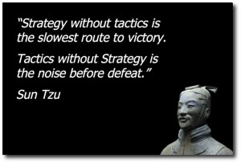
Strategies and Tactics

Slide 3

Techniques and Tactics
Probing questions
Forbearance
Silence
“Go to the Balcony”
Take a break!
Salami
Peppermint
Apparent Withdrawal
Quick close

Slide 4
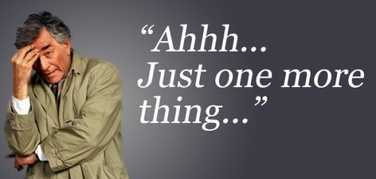
Ask Probing Questions

Slide 5







Forbearance
Hold off, suspend, put off an
answer, do not
answer directly –
patience pays!

Slide 6
Silence
Silence is the absence of mention
In other words, a negotiator using this tactic does not say anything about a negotiation point
When used as a tactic in a negotiation, silence can keep the you or the other party off-balance

Slide 7
When to Use Silence
Generally used when negotiators do not want to disclose weaknesses in their position.
  “If I listen, I have the advantage;
  if I speak, others have it.”
    ~ From The Arabic

Slide 8
When to Use Silence
Also used when negotiators want to obtain information by letting the other party do the talking
Silence gives you the powerful opportunity to observe and learn
  “We have two ears and one tongue in order that we may hear more and speak less.”
  ~ Diogenes

Slide 9
When to Use Silence
Remember …. When the other party is talking:
If you interrupt, it irritates the speaker
  “To every thing there is a season...
  a time to keep silence, a time to speak.”
  ~ Ecclesiastes

Slide 10
Go to the Balcony
William Ury
https://www.youtube.com/watch?v=Hc6yi_FtoNo

Slide 11
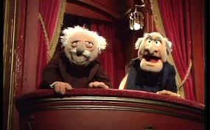
Go to the Balcony
“Going to the balcony” simply describes the mental imagery used to distance yourself emotionally from the combat zone
  It refers to the mental process of stepping back from the combative situation and seeing it objectively

Slide 12
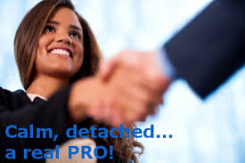
Go to the Balcony
According to Ury, from the balcony, you can assess the conflict in a more detached way.
  This allows you to consider the situation more constructively and explore solutions that are mutually satisfying.

Slide 13


Slide 14

Never make decisions in the heat of the moment.
Instead, go the balcony and make your decisions there.

Slide 15

But Don’t Forget to Expand Your Options!
Movie: “Defending Your Life”
https://www.youtube.com/watch?v=DufE-dcQ70k

Slide 16

Apparent Withdrawal

Slide 17

Slice the Salami
Agree to each point one at a time.
This way the other side can’t go back and discuss previous points if new points impact them AND…
  Little by little, you will gain information to you form a deal you want!
Insist on all issues being on the table before making any decisions.

Slide 18

Peppermint:
Give Something to Get Something

Slide 19

Quick Close

Slide 20

Overcoming an Impasse

Slide 21

Change the Game,
Change the Frame
Instead of rejecting what your opponent says, accept it- and reframe it as an opportunity to talk about the problem.
Reframing means redirecting the other side’s attention away from positions and toward the task of identifying interests, inventing creative options, and discussing fair standards for selecting an option.

Slide 22
Change the Game: Reframe
Reframe their positions to interests.
  “Why is this important to you?
Reframe their positions to options.
  “That is one option. What are some others?”
Reframe their positions to criteria.
  “Help me understand where that number is coming from.”

Slide 23
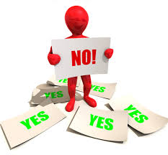
But, Make It Easy to Say No

Slide 24

Sometimes there is a need to convey a firm and clear “no.”
Sandwich the no between two “yeses.”

Slide 25
Additional Impasse Tips
Recap what has occurred
Change the subject
Attempt to secure an agreement-in-principal
Discuss remaining alternatives
Ask a hypothetical question
Diagram agreement and difference
Call it quits

Slide 26

7 Manipulative and Power Negotiation Tactics and How to Handle Them

Slide 27

PRESSURE TACTICS

Slide 28
1) Pressure Tactic: Deadlines
Deadlines pressure both parties in a negotiation to make choices and are used to create movement
Deadlines may be artificial or real
They can be external deadlines imposed by the other party or internal deadlines within your own organization
“If I don’t get your order by Friday, I can’t guarantee the delivery you need.”

Slide 29
Your Response to the Deadline Tactic
To neutralize the Deadline, test it…be skeptical
Ask questions to see how real and how firm it is.
The person setting the deadline is counting on the fact that it’s human nature to believe deadlines are real
If you decide that the deadline is real, determine where it comes from, whether an extension is possible, and what the consequences would be of missing the deadline

Slide 30

DELAY TACTICS

Slide 31
3) Delay Tactic: Limited Authority
The negotiator cites their limited ability to make a decision, creating a stall in the negotiations
The advantage of using Limited Authority is that it may lower your aspiration level
It also allows time to delay decisions
“My boss will have to authorize this.”

Slide 32
Your Response to the Limited Authority Tactic
Find out who makes decisions and arranging a way to meet with them
When possible, start negotiating with the individual who has final authority in order to prevent this tactic from being used
Try to find out what standards are used to determine whether an agreement will be authorized or not

Slide 33
4) Delay Tactic: Missing Person
Occurs when the other party acts as if the Missing Person needs to be included in the deal, wouldn’t accept something you’re suggesting, or needs to be consulted on some detail
“I can’t discuss delivery times because our scheduling manager is out for the rest
of the week.”

Slide 34
Your Response to the Missing Person Tactic
Prior to negotiating, attempt to find out who makes final decisions regarding delivery times, price, payment terms, etc.
You can also ask to set up a meeting with that person if the other party attempts to use this tactic.

Slide 35

MANIPULATIVE TACTICS

Slide 36
5) Manipulative Tactic: Moral Appeal
An attempt to remind you that the goal of the negotiation is mutual satisfaction
It appeals to your sense of fairness
It includes any statement whose purpose is to get you onto the other party’s side
“Let’s be fair. You can’t expect a firm price with the problems in the economy.”

Slide 37
Your Response to the Moral Appeal Tactic
Explain to the other party that the terms you have agreed to are in each other’s best interests
Ask probing questions to find out what will happen to the other party
What is their underlying motivation?

Slide 38

POWER TACTICS

Slide 39
6) Power Tactic: Blanketing
Saying that everyone’s doing it
Children are experts at this tactic -- however, it also appears frequently in business
The objective of the tactic is to create credibility and weaken the other side’s position
“Let’s be fair. You can’t expect a firm price with the problems in the economy.”

Slide 40
Your Response to the Blanketing Tactic
Use objective criteria to determine just what the correct (fair) provisions of your agreement should be
  For example: industry standards, rate of inflation, or standard profit margin
Ask questions to find out what the competition is offering or what deals have been drawn up with other clients
  “Who is ‘everyone’?”

Slide 41
7) Power Tactic: Association
Also known as “name dropping,” this tactic is a popular way of increasing the other party’s power in a negotiation
It can be blatant or subtle
It is most effective when true, but can be very manipulative when untrue
“This project reminds me of one I did
for Cummins.”

Slide 42
Your Response to the Association Tactic
Ask the other party probing questions to find out what they did for the other companies
  What terms did they agree to?
  How large was their order?
Get as many details as possible about what they’ve done for them in the past

Slide 43

Avoiding the Pitfall of Hidden Assumptions
First, be aware that you’re making them
Second, always test them by asking questions
Third,…

Slide 44
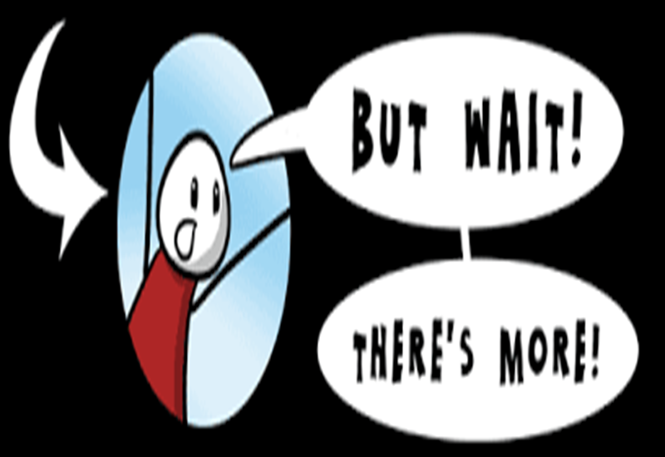
Negotiation Techniques

Slide 45

More Ethical Issues

Slide 46

More Cultural Competency

Slide 47

Closing Thought
“We cannot negotiate with those who say
‘what is mine is mine and what is yours is
negotiable.’ ”
John Fitzgerald Kennedy

